Slide 1
Medical Big Data Project

Slide 2
System Structure
Medical Big Data Project
Android Application
Web Backend
Recommendation System

Slide 3
Basic Function
Health Data Management
Online Community
Collect users’ health data: Health data from health devices like Jianqinbao blood pressure monitor and MIO fitness tracker. Users can also upload health data manually.
Review the history of health data.
Analyze users’ health data and generate personal health report.
Built-in social media platform for community.
Able to make posts, add friends, share experience and so on.
Recommendation system based on user’s data and requirements.

Slide 4
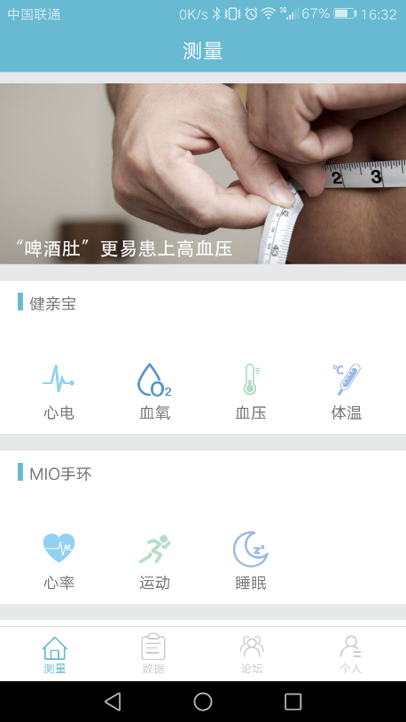
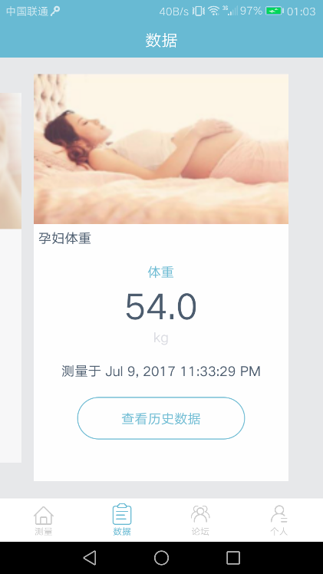
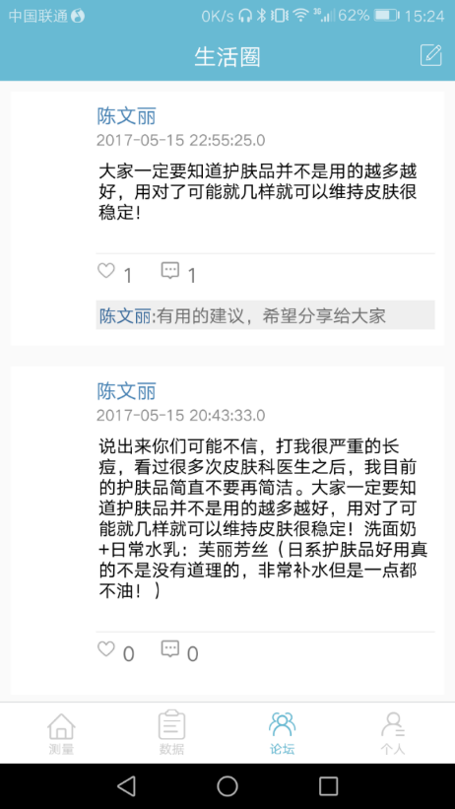
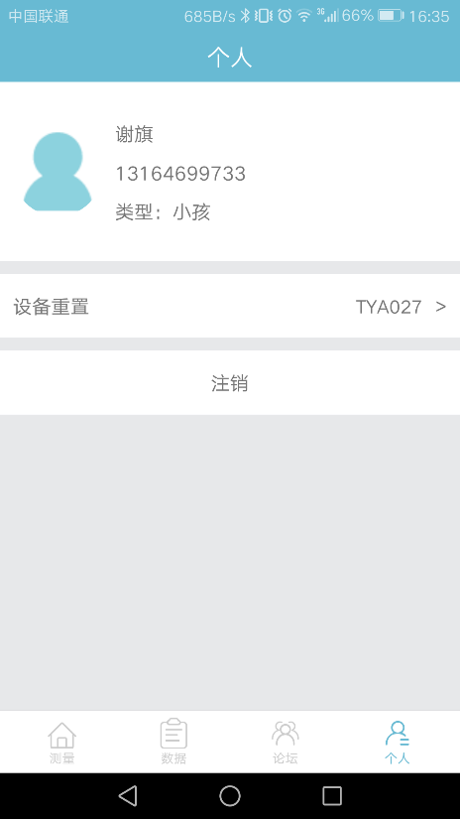
UI Design
Data Collection
Health Data Review
Community
My Account
Comment and like other users’ post
Username, phone number and user type: old people, women, children and normal.
(Ads)
The latest collected data displayed
Data from health device: measure blood pressure, blood oxygen, heart rate…
Control which device to connect with
Data from another device
Click to view history

Slide 5
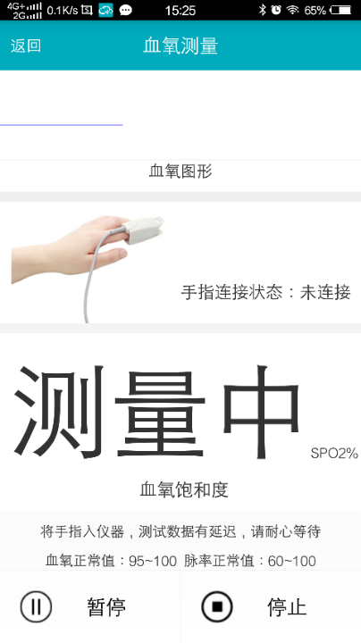
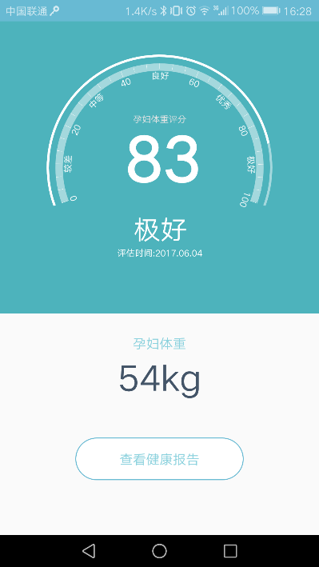
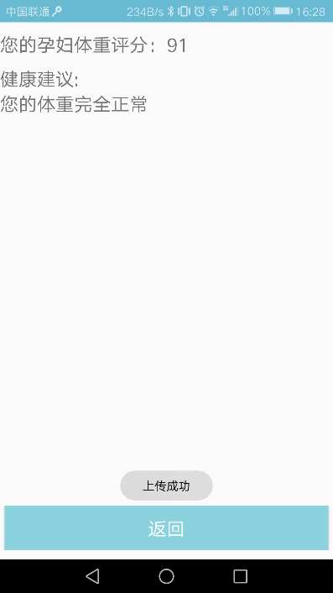
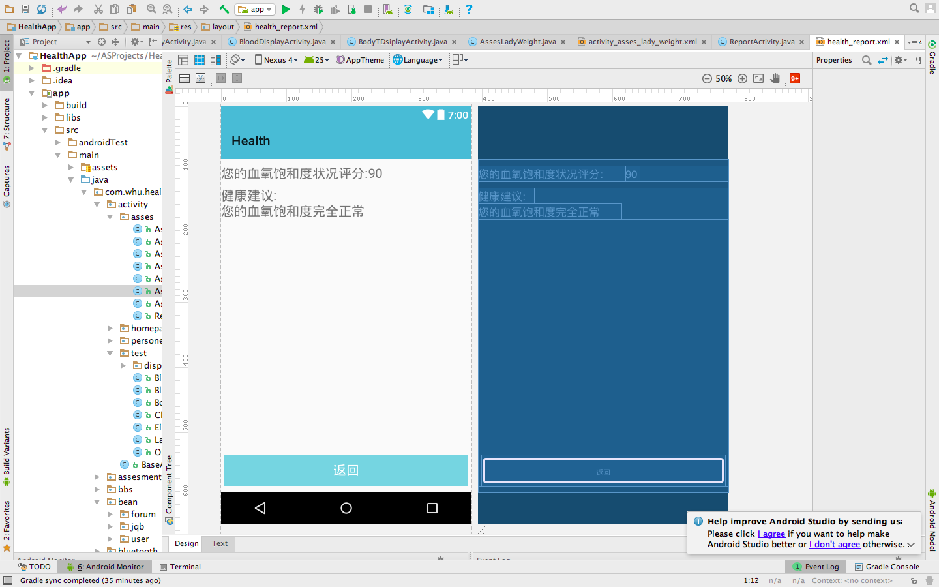
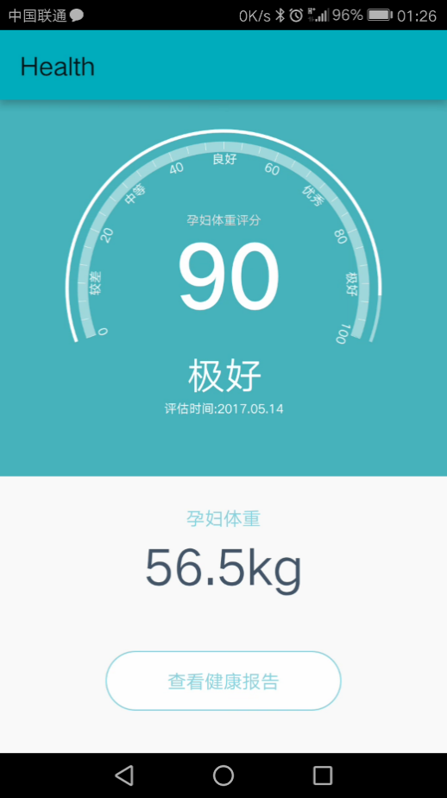
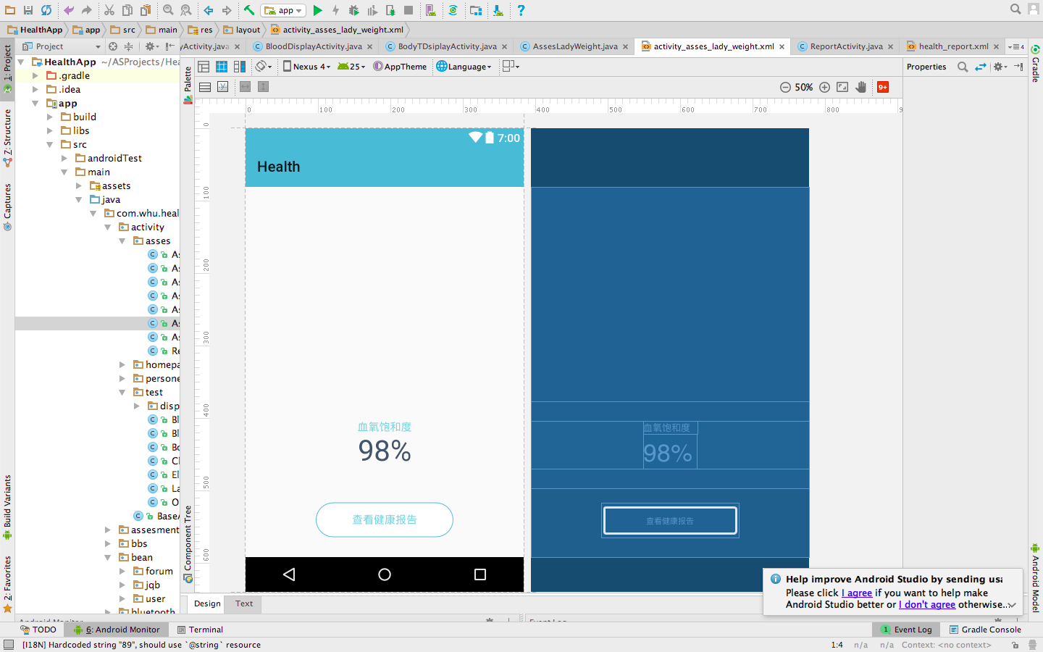
Health Data Collection-Blood Oxygen Example
Connected with medical devices and measure users' health data, then generate the rating and analysis of results.
Blood oxygen saturation: 98%, rating: 90/100
Measuring blood oxygen saturation: phone connected with health device with Bluetooth.
Analysis of result: The blood oxygen data is in normal range.

Slide 6
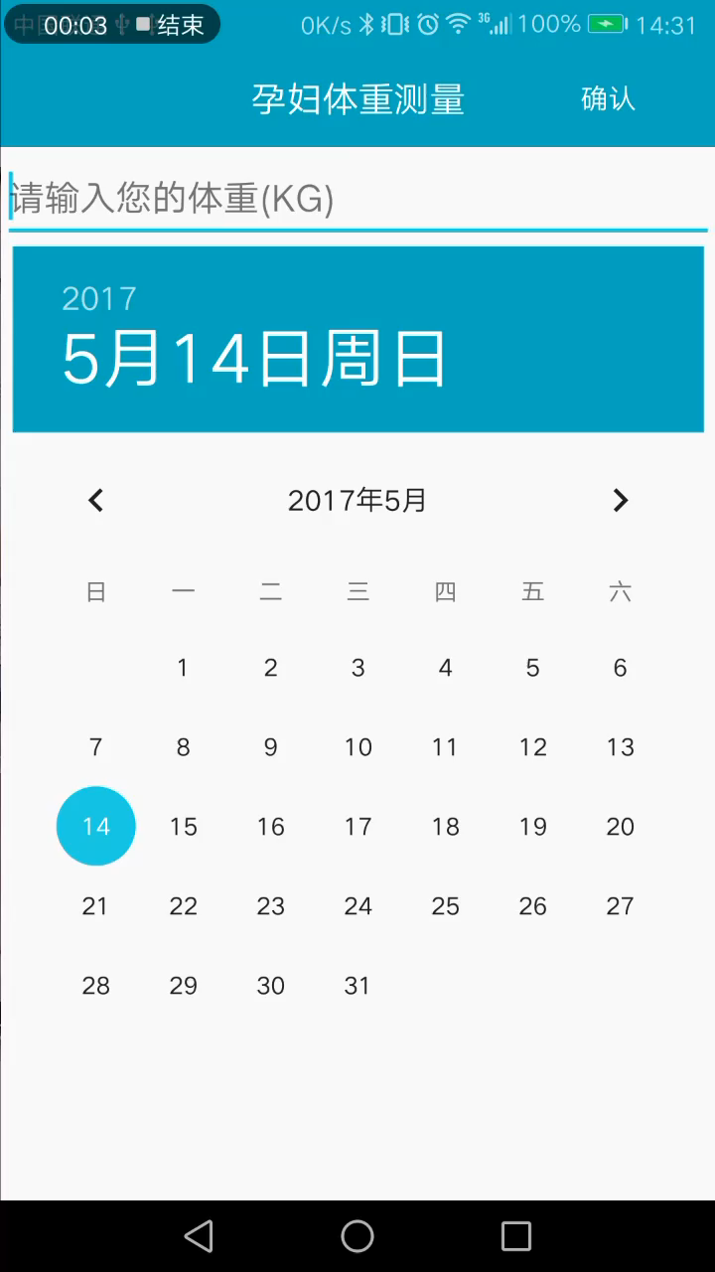
Health Data Collection-Input Manually
User can manually input health data(e.g. body weight and temperature)
(Click to play the video)
Input weight: 56.5kg
Rating: 91/100,in normal range.

Slide 7
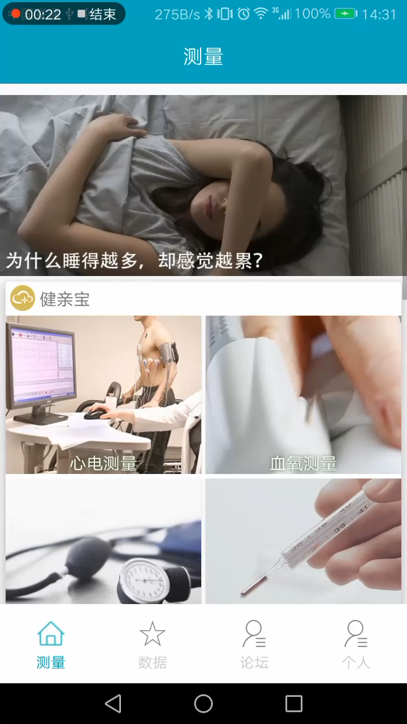
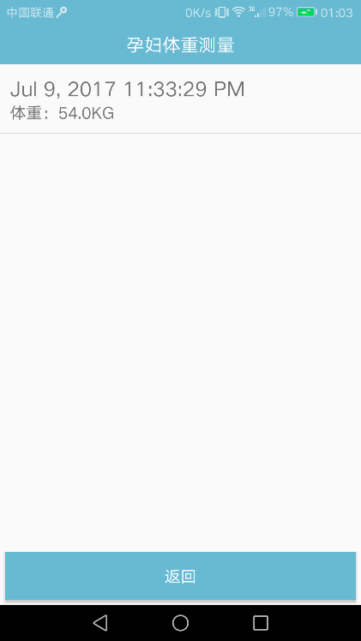
Health Data Review: View history
Latest measured data are displayed on homepage, select and click to view history health data:
Click to play the video: review the health data history
Detailed history data: date and value

Slide 8

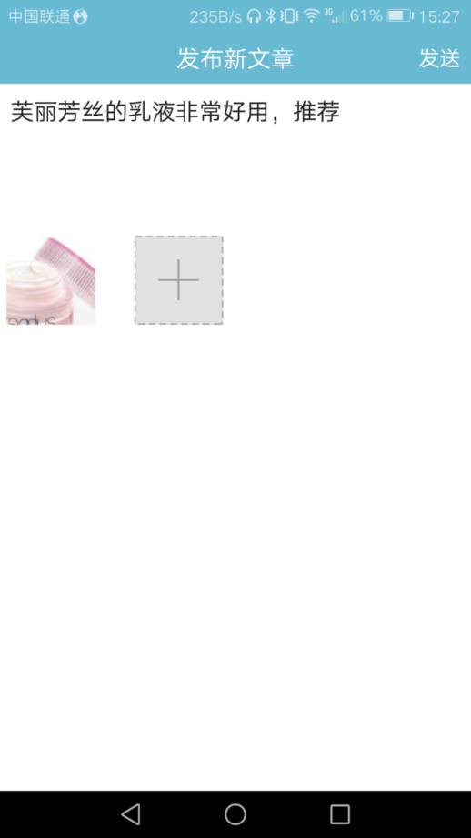
Health Community
Able to make posts, comment and like other’s posts, add friends, share experience and so on.
Making a new post with at most 9 photos. Support uploading from gallery or taking photos from camera.

Slide 9
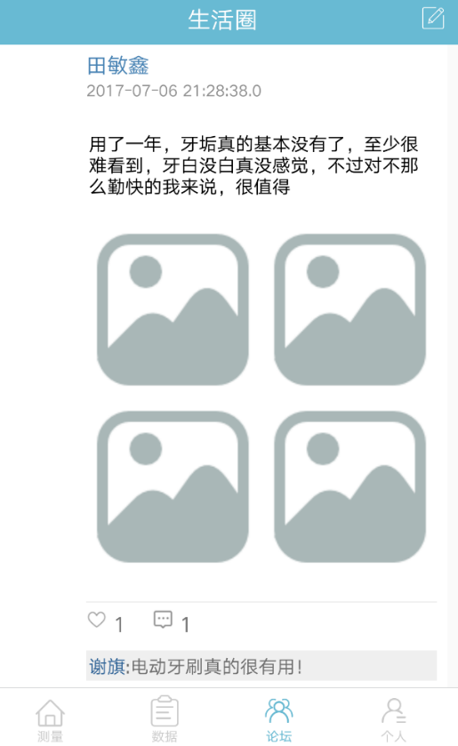
Health Community
Interact with recommendation system in backend. The backend will analyze the users' data and recommend other users’ related posts or potential Ads to current user.
Here’s an example in this image. After user make posts about teeth tartars, the backend will recommend related posts from other users. User could comment and like the recommended posts, which makes the community more active and interactive. This feature would also be fit in potential advertising.

